Slide 1

Airbnb Successful Listing Prediction
-Dhinakaran Chandrasekar

Slide 2
Outline
Introduction to Airbnb and the base of the analysis
Understanding the data with visualizations
Feature Engineering
Insights from the model
Summary and Applications

Slide 3
Introduction to Airbnb and the base of the analysis

Slide 4
Airbnb is an online platform that connects people looking to rent or lease short-term lodging in residential properties, offering a unique and often more personalized alternative to traditional hotels.
The dataset for prediction is take from CitySource which is often employed to gather large-scale data from various sources, aiding in urban planning, market research, and analysis of trends for informed decision-making.
Examined various aspects to gauge the success of Airbnb listings, uncovering crucial factors for consideration.
Variables such as location, pricing, amenities, and guest reviews were taken into consideration to discern their impact on the overall success of Airbnb listings.

Slide 5
Understanding the data with visualizations

Slide 6
Before we get into feature engineering, it is important to gather some domain knowledge and to understand the nature of the dataset
Once we are done cleaning the dataset and have dealt with outliers and made sure that there is no bias in the dataset, we can play around with the dataset to get a better understanding
A simple bar graph could tell us the distribution of the variable
There are some missing values in the dataset for some important variables but meanwhile the same variable can be extracted from another variable. For example, the number of bedrooms available in the listing was missing in some places. So instead we can extract the details from the name of the listing where it is mentioned.

Slide 7
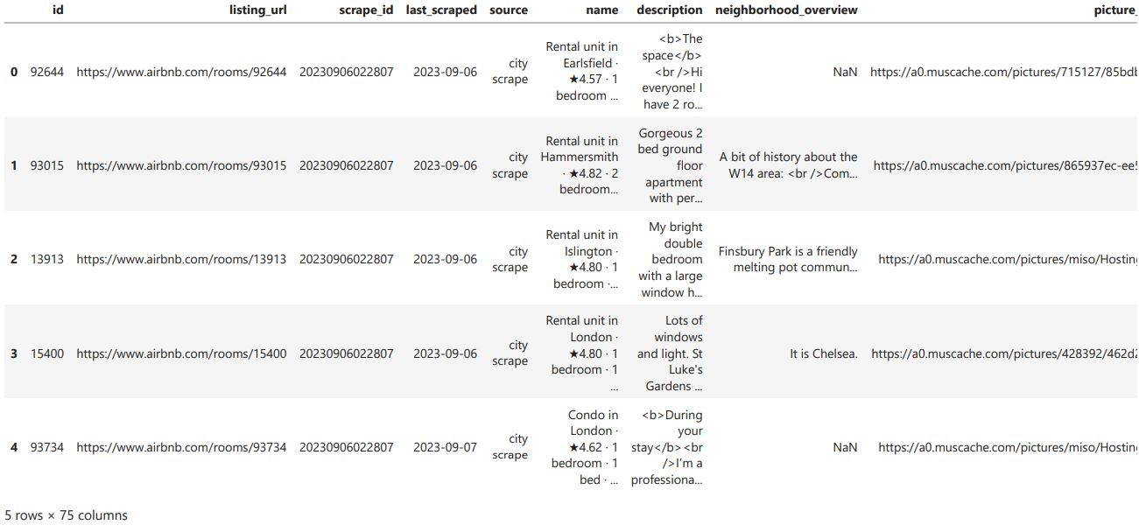
A sample of the data

Slide 8
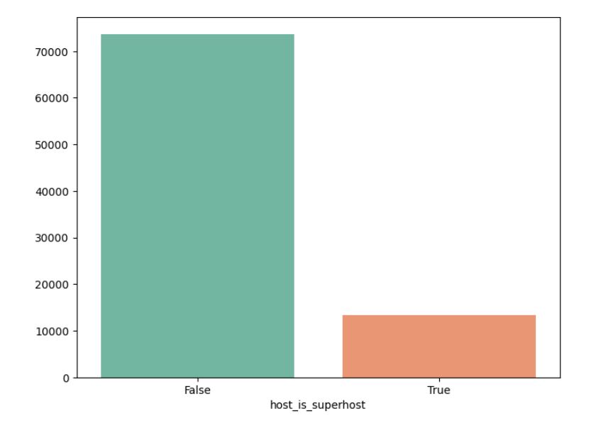
Is the host a Superhost?
Superhost status on Airbnb is awarded to hosts who consistently provide exceptional hospitality, meeting high standards in hosting experiences.

Slide 9
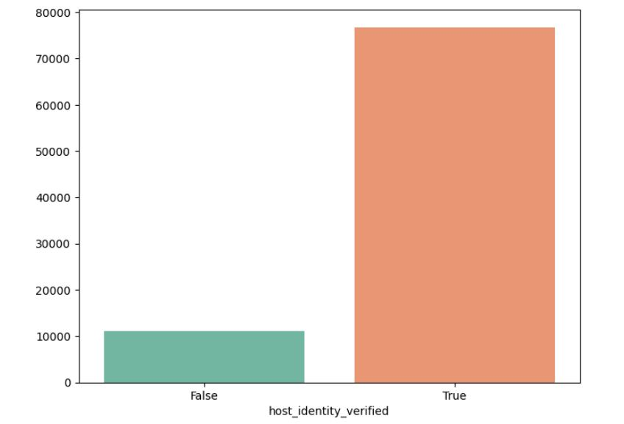
Is the host verified?
Host verification in Airbnb involves hosts confirming their identity through official documents, enhancing trust and credibility in the hosting community.

Slide 10
Just from the above 2 bar graphs we can see how some variables won’t play a big role in our model even though they seem quite important.
There are a very less percentage of hosts who are superhosts in this dataset, but that doesn’t mean that the hosting hosted by the remaining hosts are unsuccessful.
In the same way almost 90% of hosts on the dataset are verfied and that also doesn’t mean that they all have a very successful listing.
This is where feature engineering plays a major role to the get the right variables to use in the model for best possible result
Also there is no direct dependent variable in the dataset, so this is also a good way to make sure that neither superhost or the verified column is the dependent variable

Slide 11
Feature Engineering

Slide 12
An Example of the feature engineering used:
One of the important factors in a listing is the amenities available in the place.
So I have taken the top 10 most common amenities from the dataset
Then I created new columns for all the amenities
All these new variables tells us is that 1 particular amenity is available in the listing or not
I then created a new column and named it amenities sum which has the total number of amenities the listing has from the top 10 common amenities
Now the "amenities_sum" column can go in our model as one of the independent variables to help with the prediction
Since there is no defined dependent variable, I have given weightage to all selected variables and have grouped them into 3 categories (good, bad and average) and have named it "classification"

Slide 13
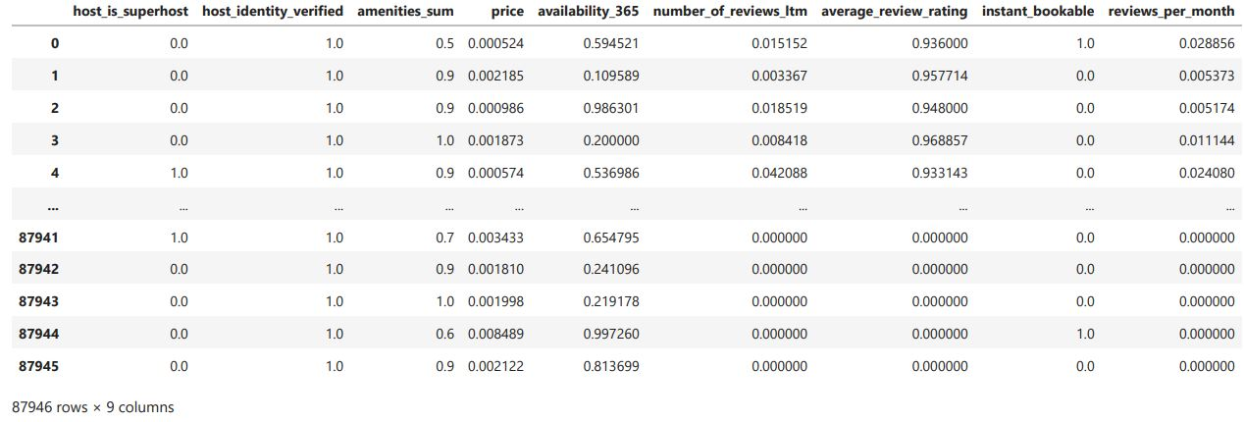
Sample of the dataset after Feature Engineering

Slide 14
Output of the model

Slide 15
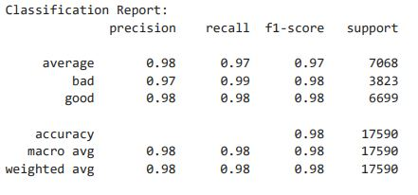
Classification report for the model:
The classification report in logistic regression summarizes precision, recall, and F1-score for each class.
Precision measures prediction accuracy, while recall gauges actual positive instance coverage.
The F1-score balances these metrics, offering a comprehensive view of model performance.
Support indicates the number of actual occurrences of each class in the dataset, making it a valuable tool for model evaluation.

Slide 16
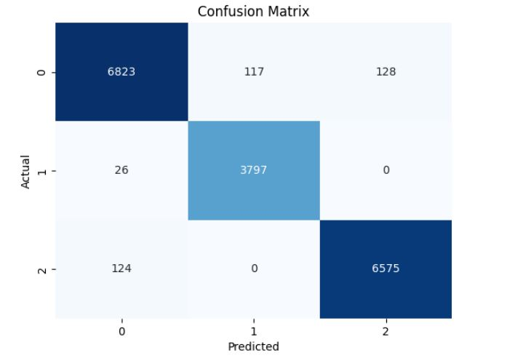
Confusion matrix for the classification report
The confusion matrix helps us to understand the distribution of the predicted values(predicted right and wrong)
All the values in the blue boxes indicates the number of correctly predicted listings
The values in the grey area represents the wrong predictions made by the model
This gives us an idea of how well the model works

Slide 17
Summary and Applications

Slide 18
Summary:
Now we have a regression model that can predict the success of a listing on Airbnb.
Since we decided the weightage for every variable used in the model, we can get an idea of the most impactful variables affecting the success of the listing based on the rules built by us.
Here, we know that the reviews, ratings, amenities and the price of the listing plays a major part in predicting the success of the listing
This model can be used to give custom recommendations to hosts on improving their listings and hence impacting the revenue brought into the company by that particular listing
Since Airbnb has a host rating and host review system, this model can be used to match the right pair. A high rated user can be matched with a superhost to maintain the experience of the hosts too since the hosts on Airbnb are also users.
Applications:

Slide 19
Future Improvements

Slide 20
There is a lot of room for improvement in this model
Since, we decided the metrics on which the dependent variable was chosen for the model, it could not be very relevant when used on the actual platform
A good quality of data could impact the model in huge way since we saw a lot of missing values in the dataset
Also using time series analysis could be a better option since the availability of the listing varies depending on seasons, local events or even economical factors
In this model we have just used the numeric part of the dataset. Maybe using user sentiment analysis like Natural Language Processing could bring some change into the output.

Slide 21
Questions?

Slide 22
Thank You
-Dhinakaran Chandrasekar

